Slide 1
Project Management
3

Slide 2
Why Project Management?
Many tasks do not fit neatly into business-as-usual
Projects integral to organizational strategy
Need to assign responsibility and authority for achievement of organizational goals
Pervasive history of failed projects

Slide 3
Definition of a Project
A project is a temporary endeavor undertaken to create a unique product, service, or result

Slide 4
What is Project Management?
Application of knowledge, skills, tools and techniques to project activities in order to meet project requirements.
Managing a project includes:
Identifying requirements
Establishing clear and achievable objectives
Balancing the competing demands of quality, scope, time and cost
Adapting the specifications, plans, and approach to the different concerns and expectations of the various stakeholders

Slide 5
Process Groups
Initiating
Process
Planning
Process
Executing
Process
Monitor &
Control
Process
Closing
Process
Initiating – Defines / authorizes the project or project phase
Planning – Defines / refines objectives, plans course of action required to attain the objectives / scope that the project was undertaken to address
Executing – Integrates people and other resources to carry out the project management plan for the project.
Monitor & Controlling – Regularly measures and monitors progress, identifies variances so corrective action can be taken
Closing – Formalizes acceptance of the product, service or result and brings the project to an orderly end.

Slide 6
Characteristics of Projects
The 3 Key Characteristics
Time
Budget
Scope

Slide 7
Operational Definition
An operational definition is a description of something—such as a variable, term, or object—in terms of the specific process or set of validation tests used to determine its presence and quantity. Properties described in this manner must be publicly accessible so that persons other than the definer can independently measure or test for them at will. An operational definition is generally designed to model a conceptual definition.*
Consider the different temperature units (F, C, R, K)

Slide 8
PM’s First Job
Understand the expectations that the organization has for the project
Ensure stakeholder needs are met
Determine budget/resources needed
Budget
People
Equipment
Identify who among senior managers has a major interest in the project
Determine if anything about the project is atypical

Slide 9
Priority Matrix
Goal, one high, one medium, one low
Engage in the discussion early
Better to have the understanding at the start
Overdetermined?

Slide 10
Operations vs Project Management
Attribute | Operation Management | Project Management
Time | On-going | Temporary
Budget | Predictable/Established | Per scope statement
Scope | Relatively defined | Complex, changing
Tasks | Repetitive/Cyclical | Unique
Staff | Stable | Established at project start
Definition of Success | Keep status quo | Delivery of scope
Leadership style | Manager | Leader (disruptive)
Impact on Company | Regular revenue supports need | Find funding and justify
Organization | Functional | Usually cross-functional

Slide 11
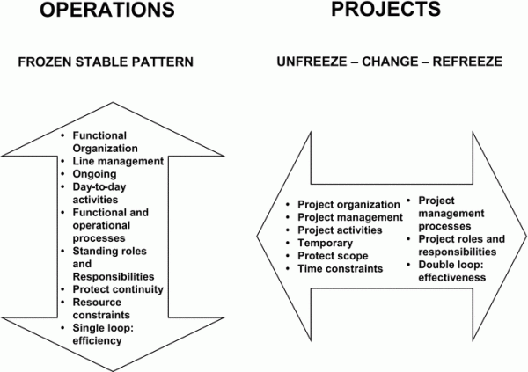
Another View
https://managingtraining.wordpress.com/2013/10/12/2-characterisitcs-of-highly-successful-training-leaders-synergizing-projects-and-operations/

Slide 12
Planning - Two Extremes
“Ready, Fire, Aim”
Analysis Paralysis
Fall 2009
12

Slide 13
Completion Time
Average Completion Times
What does the mean completion time mean?
Assuming Known Activity Times
Can lead to unrealistic project completion times.

Slide 14
Uncertainty of Completion Time
Generally it is assumed that times are “set” or deterministic, that is no variation or error
Always error that should be accounted for
Already discussed Time Expected (TE)
TE weights times based on likelihood of occurring
Assume activities are statistically independent
Impacting one doesn’t affect another
Variance of a set of activities is the sum of the individual variances
Interested in variances along the critical path

Slide 15
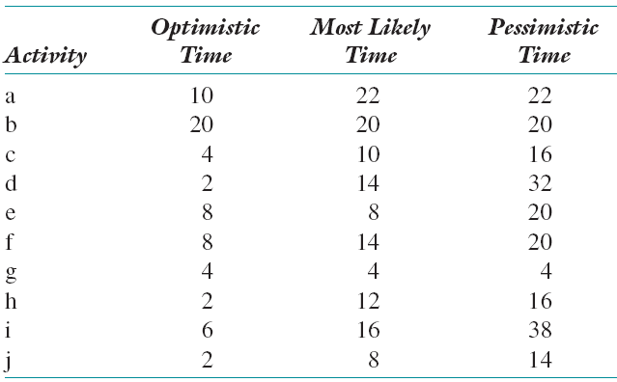
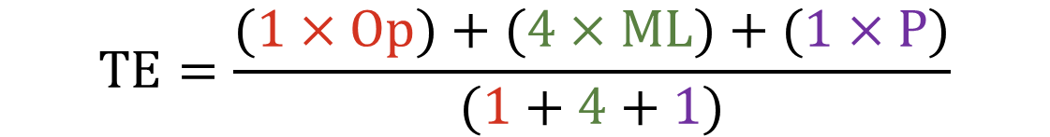
Calculating Activity Times
TE = Time Expected
$$TE=\frac{(1×Op)+(4×ML)+(1×P)}{(1+4+1)}$$

Slide 16
Table of Time Estimates

Slide 17
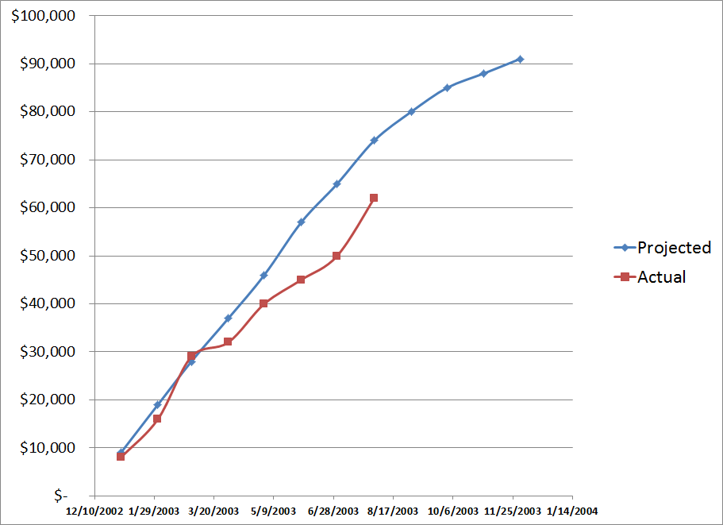
How’s This Project Doing?

Slide 18
Earned Value Analysis
Industry standard way to
Measure a project’s progress
Forecast its completion date and final cost
Provide schedule and budget variances along the way
It’s been around since the sixties.
“Cost/Schedule Control Systems Criteria” (C/SCSC)
By integrating three measurements, EVA provides consistent, numerical indicators with which you can evaluate and compare projects.

Slide 19
Three Key Questions
Knowing where you are on schedule?
Knowing where you are on budget?
Knowing where you are on work accomplished?

Slide 20
EVA Integrates All Three
EVA compares the PLANNED amount of work with what has actually been COMPLETED, to determine if COST , SCHEDULE, and WORK ACCOMPLISHED are progressing as planned.
Work is “Earned” or credited as it is completed
Different methods to determine % complete
0% or 100%
0%, 50% or 100%
25%, 50%, 75%, 90% ...
Notes:
(2) Thus the name Earned Value; you can actually assign a VALUE to the project at a particular time

Slide 21
Earned Value is Needed
Provides an “Early Warning” signal for prompt corrective action
Bad news does not age well
Still time to recover
Timely request for additional funds

Slide 22
Definitions & TLA’s
AC: Actual Cost
PV: Planned Value
BAC: Budget at Completion
EV: Earned Value (value completed) percent completion of work * planned cost
SV: Schedule Variance = EV - PV
CV: Cost Variance = EV – AC
SPI: Schedule Performance Index = EV / PV
CPI: Cost Performance Index = EV / AC

Slide 23

Planned Value (PV)
Planned cost of the total amount of work scheduled to be performed by the milestone date
Budget
Calculated using BAC and progress
$$PV=BAC x\frac{Current week}{Total Weeks}$$

Slide 24
Actual Cost of Work Performed (AC)
Cost incurred to accomplish the work that has been done to date

Slide 25
Earned Value (EV)
The planned (not actual) cost to complete the work that has been done.
EV = BAC x % complete
Multiply the estimated percent work complete for each task by the planned cost
Earned Value gives a measurement of how much has been accomplished in monetary terms, based on the “value” inherent in the budget
Earned value incorporates work accomplished
Only need percent complete estimate for tasks currently in progress
Notes:
The next factor is BCWP and this is the factor that rounds out EVA and makes it possible to capture the full picture of where the project stands.
Note that this is the cost of the work performed and,it is the budgeted amount, not the actual amount.

Slide 26
EVA Example
A $10,000 software project is scheduled for 4 weeks.
At the end of the third week, the project is 50% complete and the actual costs to date is $9,000
Calculate BAC, PV, EV, and AC
Budget at Completion (BAC) = $10,000
Actual Cost (AC) = $9,000
Planned Value (PV) = $7,500
Earned Value (EV) = $5,000

Slide 27
Variances
Variances can help analyze a project
A negative variance is bad
Cost and schedule variances are calculated as the earned value minus some other measure
Will look at some of the more common ones

Slide 28
Cost Variance (CV)
CV = EV – AC
Negative variance indicates a cost overrun
Magnitude depends on the costs
EV = Earned Value
AC = Actual Costs

Slide 29
Schedule Variance (SV)
SV = EV – PV
Negative variance indicates you are behind schedule
Measured using costs
EV = Earned Value
PV = Planned Value

Slide 30
Indices
Cost Performance Index
CPI = EV/AC
Schedule Performance Index
SPI = EV/PV
Time Performance Index
TPI = ST/AT
Cost Schedule Index
CSI = CPI x SPI

Slide 31
EVA Example
A $10,000 software project is scheduled for 4 weeks.
At the end of the third week, the project is 50% complete and the actual costs to date is $9,000
Calculate BAC, PV, EV, and AC
Budget at Completion (BAC) = $10,000
Planned Value (PV) = $7,500
Earned Value (EV) = $5,000
Actual Cost (AC) = $9,000

Slide 32
EVA Example Calculations
Schedule Variance
= EV – PV = $5,000 – $7,500 = - $2,500
Schedule Performance Index (SPI)
= EV/PV = $5,000 / $7,500 = 0.67
Cost Variance
= EV – AC = $5,000 - $9,000 = - $4,000
Cost Performance Index (CPI)
= EV/AC = $5,000 / $9,000 = 0.56
Objective metrics indicate the project is behind schedule and over budget.
On-target projects have an SPI and CPI of 1 or greater

Slide 33
Shortcomings of Earned Value
Quantifying/measuring work progress can be difficult!!!!!!!!!!!!!!!!!!!!
Time required for data measurement, input, and manipulation can be considerable.

Slide 34
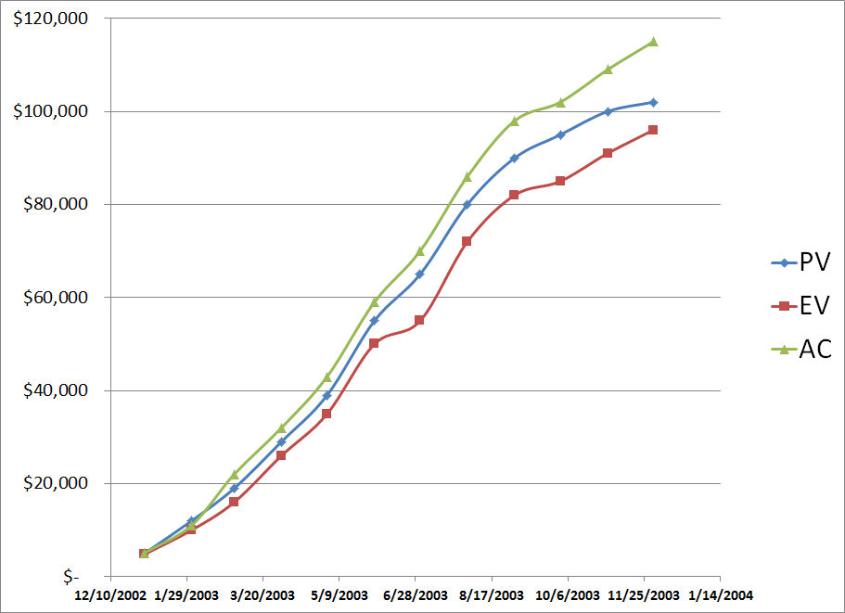
The Whole Story

Slide 35
Ineffective Scheduling
Notice:
As of tomorrow, employees will only be able to access the building using individual security cards. Pictures will be taken next Wednesday, and employees will receive their cards in two weeks.

Slide 36
Background
Schedule is the conversion of a project action plan into an operating timetable
Basis for monitoring a project
One of the major project management tools
Work changes daily, so a detailed plan is essential
Not all project activities need to be scheduled at the same level of detail
Most of the scheduling is at the WBS level, not the work package level
Only the most critical work packages may be shown on the schedule
Most of the scheduling is based on network drawings

Slide 37
Terminology
Activity - A specific task or set of tasks that are required by the project, use up resources, and take time to complete
Event - The result of completing one or more activities
Network - The combination of all activities and events that define a project
Drawn left-to-right
Connections represent predecessors
Path - A series of connected activities
Critical - An activity, event, or path which, if delayed, will delay the completion of the project
Critical Path - The path through the project where, if any activity is delayed, the project is delayed
There is always a critical path
There can be more than one critical path
Sequential Activities - One activity must be completed before the next one can begin
Parallel Activities - The activities can take place at the same time
Immediate Predecessor - That activity that must be completed just before a particular activity can begin

Slide 38
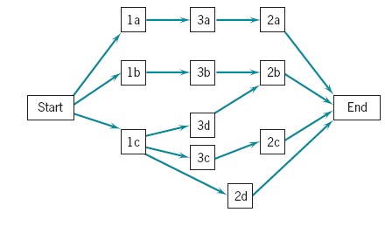
Network Diagram Format

Slide 39
Perform a Critical Path Analysis
The critical path is the longest path through the network
The critical path is the shortest time in which the project can be completed
Any delay in critical path activities delays the project
Critical path activities have no slack time

Slide 40
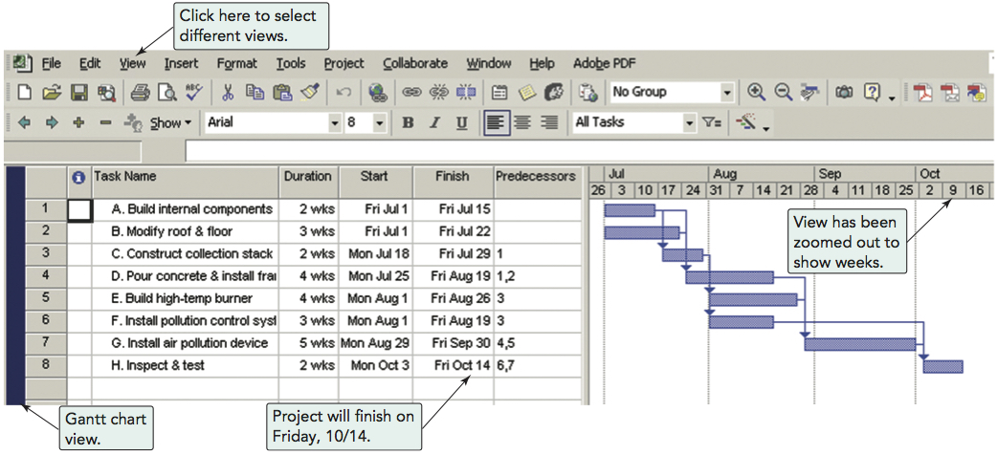
Using Microsoft Project

Slide 41
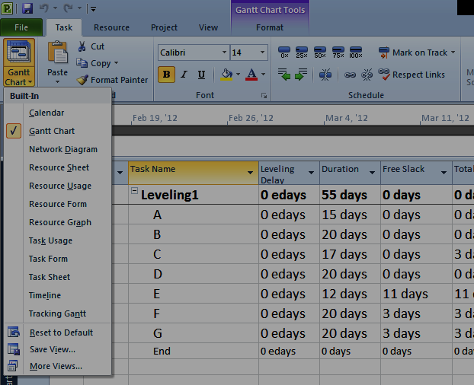
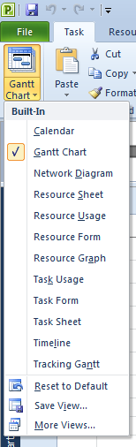
MS Project – Options

Slide 42
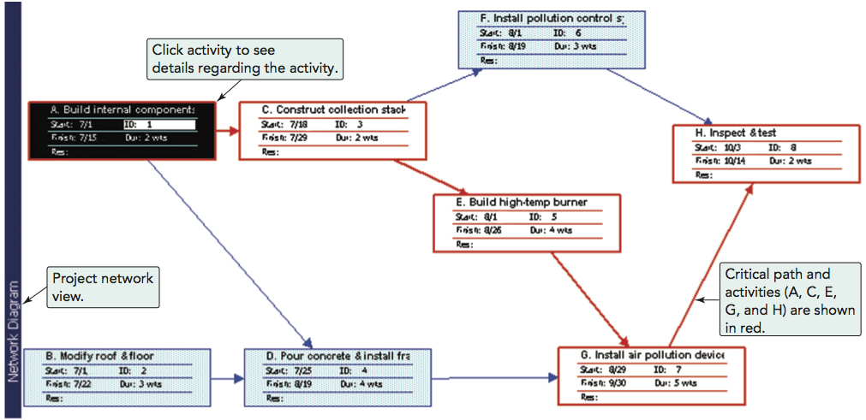
Using Microsoft Project
Program 3.2

Slide 43
Practice Problem
Develop a network diagram for project below and complete the table.
Activity | Immediate Predecessors | Best Case | Most Likely | Worst Case | TE
A | -- | 2 | 3 | 8
B | A | 6 | 8 | 11
C | B | 3 | 3 | 3
D | B | 9 | 11 | 14
E | C, D | 3 | 5 | 8
F | E | 7 | 8 | 10

Slide 44
Practice Problem – Solution
Activity | Immediate Predecessors | Best Case | Most Likely | Worst Case | TE
A | -- | 2 | 3 | 8 | 3.7
B | A | 6 | 8 | 11 | 8.2
C | B | 3 | 3 | 3 | 3.0
D | B | 9 | 11 | 14 | 11.2
E | C, D | 3 | 5 | 8 | 5.2
F | E | 7 | 8 | 10 | 8.2
C, 3.0
Start
End
A, 3.7
B, 8.2
E, 5.2
F, 8.2
D, 11.2

Slide 45
Project or Not?
Assemble a Ford Mustang
Build a satellite
Write a book
File taxes
Teach a class
Build a house
Cut down a tree
Mow a lawn

Slide 46
Project Plan
Maps the project start to finish
“Contains sufficient information that, at any time, the PM knows what remains to be done, when it needs dones, with what resource, by whom, when the task will be completed, and what specifications the output should meet.”1
Organized by the PMI process groups with relevant knowledge areas discussed
More detailed than the project charter

Slide 47
Network Scheduling Advantage
Consistent framework
Shows interdependences
Shows when resources are needed
Facilitates proper communication
Determines expected completion date
Identifies critical activities

Slide 48
Network Scheduling Advantage Continued
Shows which of the activities can be delayed
Determines start dates
Shows which task must be coordinated
Shows which task can be run parallel
Relieves some conflict
Allows probabilistic estimates

